Slide 1




Ephemeral test environments with Azure DevOps, Docker & AKS
Maciej Misztal Cloud Technical Lead / Lead .NET Developer

Slide 2
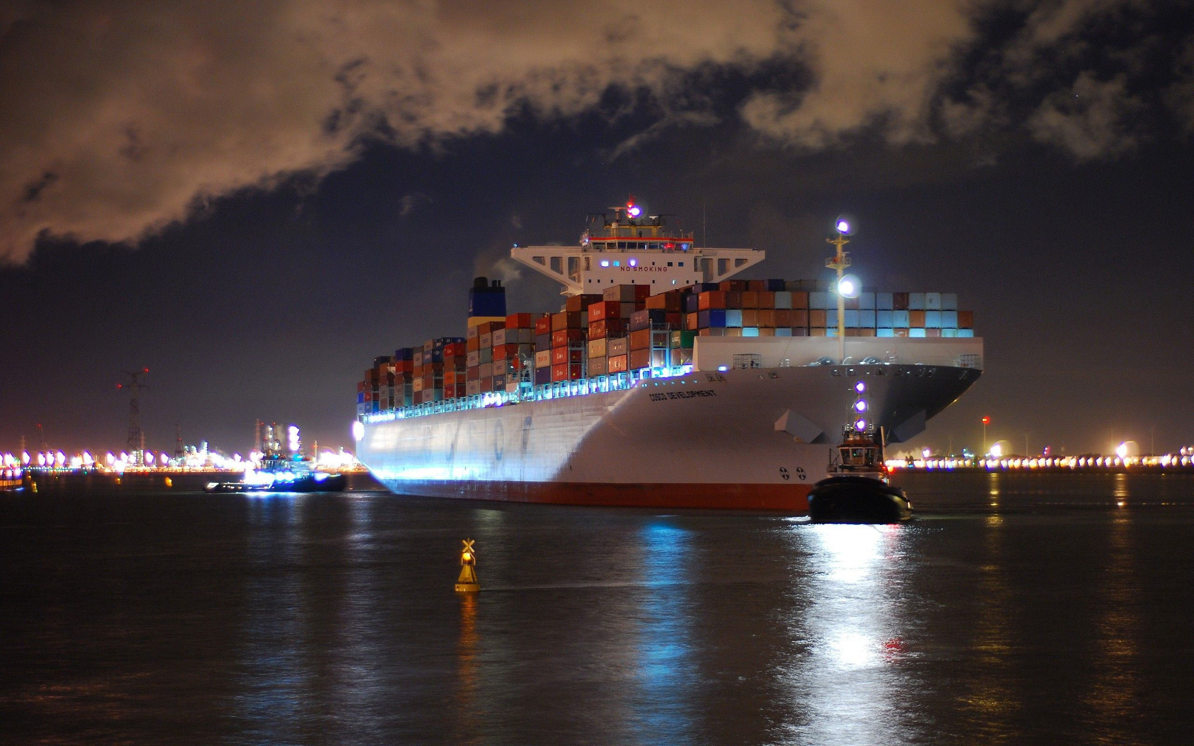






Ephemeral test environments with
@mmisztal1980
60m

Slide 3








@mmisztal1980

Slide 4



25.04 @Warsaw #SaveTheDate

Slide 5

Foreword
I assume you already know most of the basics

Slide 6

2 weeks later…
1 month later…
(The guy, who was supposed to build your new test environment)

Slide 7
But why?

Slide 8
Because some things can’t be mocked …

Slide 9
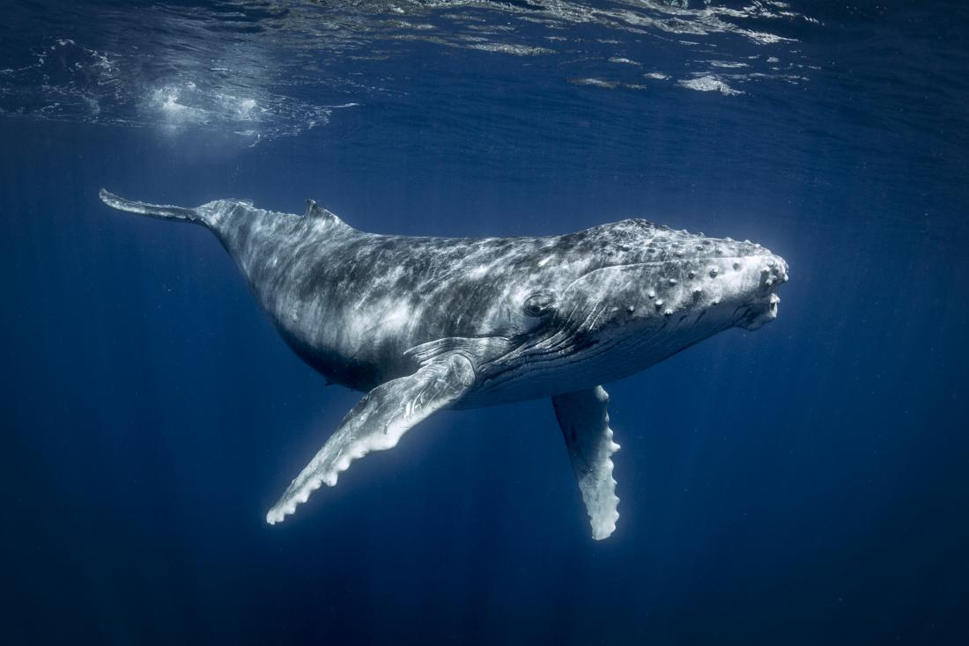
Docker to the rescue

Slide 10
Docker-Compose
docker-compose -f docker-compose.yml –f docker-compose.override.yml –f my-docker-compose.yml up
(options)
(command)

Slide 11
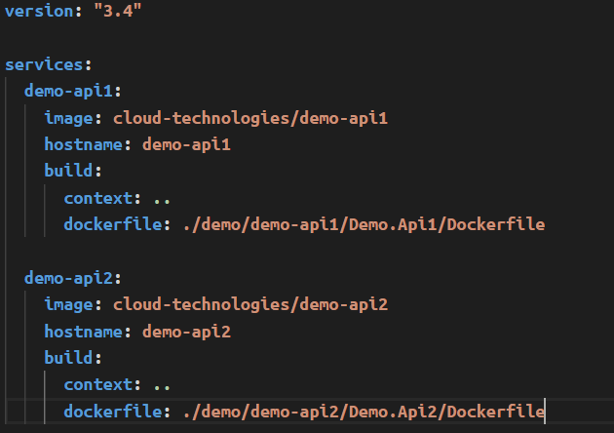
Docker-Compose (Example)
Docker Network (default) & DNS

Slide 12
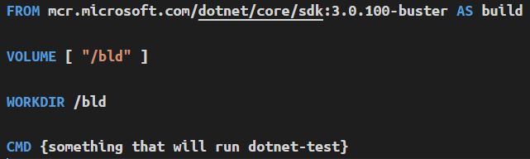
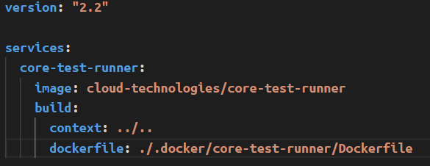
Ephemeral test env using Docker-Compose
Docker Network (default) & DNS

Slide 13
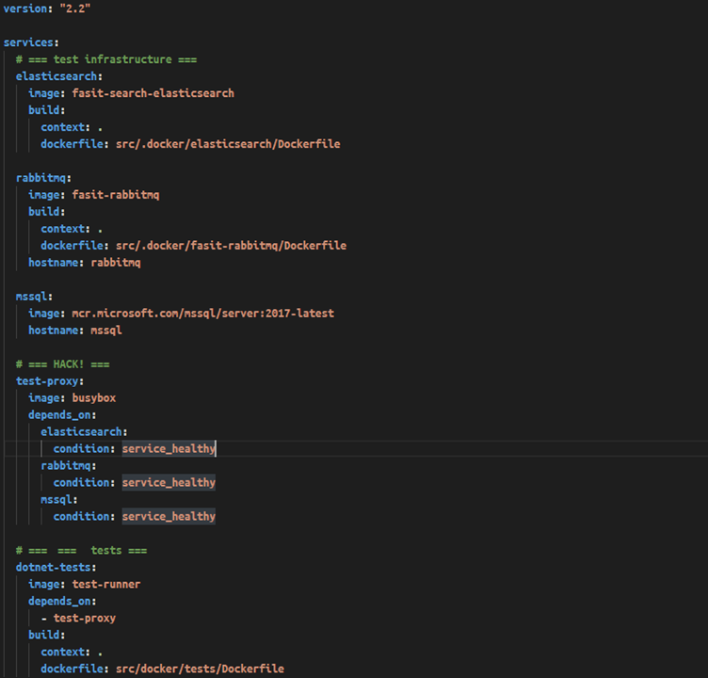
Startup Synchronization
docker-compose run dotnet-tests
No host-port bindings !!!

Slide 14
Ephemeral test env CI isolation
docker-compose -f docker-compose.yml
-f docker-compose.override.yml
-p $(Build.BuildNumber)
up
(options)
--project-name
(command)

Slide 15
This is good for PR-level integration testing
but it’s hardly enough …

Slide 16
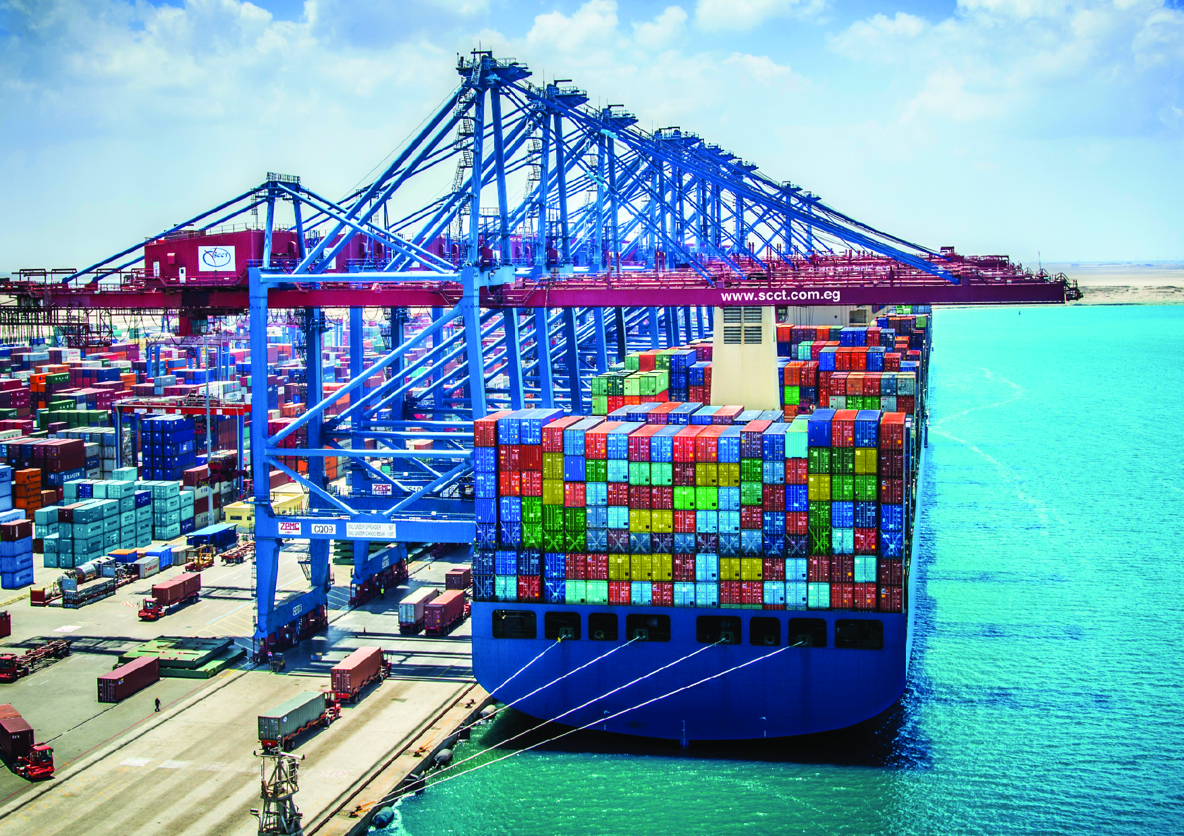
Kubernetes
Refresher
Notes:
Kubernetes is the leading container orchestrator
trends.gogle.com

Slide 17

Kubernetes Pods
app=demo-app-web
version=123
Notes:
Free for up to 5 users
Access to Hosted Agent Queues (Win/Linux)
You can have any numer of agents you want
Pipelines control how many paralel agents can be active

Slide 18
Kubernetes Deployments
apiVersion: apps/v1
kind: Deployment
metadata:
name: nginx-deployment
spec:
replicas: 3
strategy:
type: RollingUpdate
rollingUpdate:
maxUnavailable: 0
maxSurge: 1
template:
metadata:
labels:
app: nginx
spec:
containers:
- name: nginx
image: nginx:1.7.9
ports:
- containerPort: 80
Replica Set
Notes:
Free for up to 5 users
Access to Hosted Agent Queues (Win/Linux)
You can have any numer of agents you want
Pipelines control how many paralel agents can be active

Slide 19
Kubernetes Services
Service
app=demo-app-web
Reliable IP
Reliable Port
Reliable DNS
version=123
Label Selector
Notes:
Free for up to 5 users
Access to Hosted Agent Queues (Win/Linux)
You can have any numer of agents you want
Pipelines control how many paralel agents can be active

Slide 20
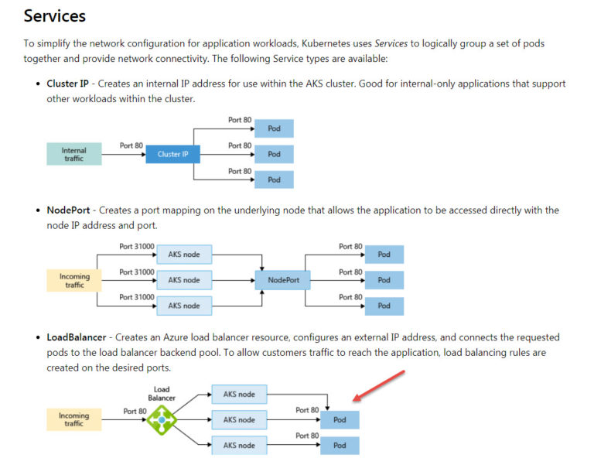
Kubernetes Services
https://bit.ly/2U0dbGe
Notes:
Free for up to 5 users
Access to Hosted Agent Queues (Win/Linux)
You can have any numer of agents you want
Pipelines control how many paralel agents can be active

Slide 21


Kubernetes Ingress
/service2
Loadbalancer
port 80 | 443
port 80 | 443
port 80 | 443
ingress service
service1
service2
pod
pod
pod
pod
k8s node
k8s node
k8s node
Notes:
Free for up to 5 users
Access to Hosted Agent Queues (Win/Linux)
You can have any numer of agents you want
Pipelines control how many paralel agents can be active

Slide 22
Ephemeral test env CI isolation
namespace1
namespace2
namespace3
pr1234
State?

Slide 23
But how do we get there?

Slide 24
(Still not there yet)

Slide 25
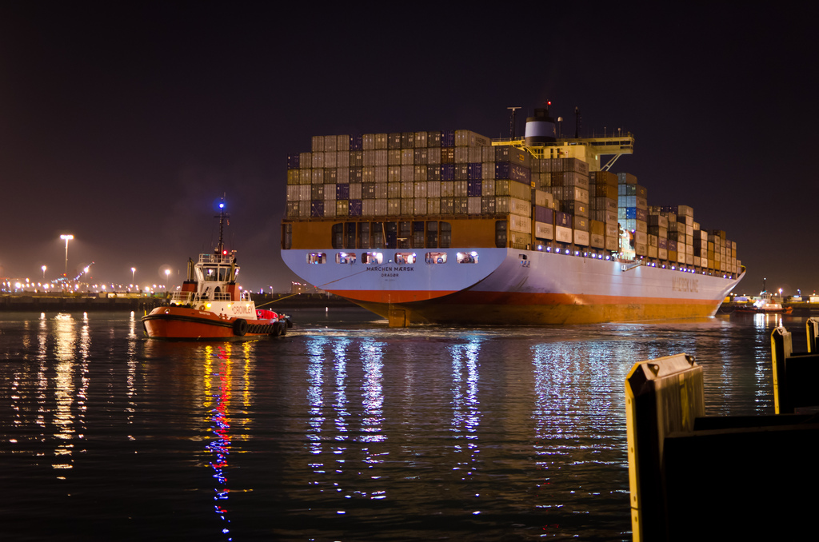
AKS Setup
Notes:
Kubernetes is the leading container orchestrator
trends.gogle.com

Slide 26


DNS Setup
A {PUBLIC_IP} mydomain.com A {PUBLIC_IP} *.mydomain.com
{PUBLIC_IP}
Node
Node
Node
ingress service

Slide 27



SSL Setup
cert-manager
kubed
pr1234
kubed label

Slide 28


SSL Setup
DNS01 Challenge
DNS Zone Contributor
- my-domain.com
- *.my-domain.com
TXT _acme-challenge.my-domain.com = _acme-challenge.my-domain.com, TTL 1800

Slide 29
So how do we automate this…?

Slide 30

Let’s consider our tooling options…
kubectl

Slide 31
Azure DevOps YAML Pipelines

Slide 32
Pipeline basics
Schedule trigger
Pipeline
Pipeline
PR trigger
Pipeline trigger
Push trigger (CI)

Slide 33
Pipeline basics
Stage
Stage
Stage
Stage
Job
Job
Task
Job
Task
Job
Task
Job
Task

Slide 34
What else is there?

Slide 35
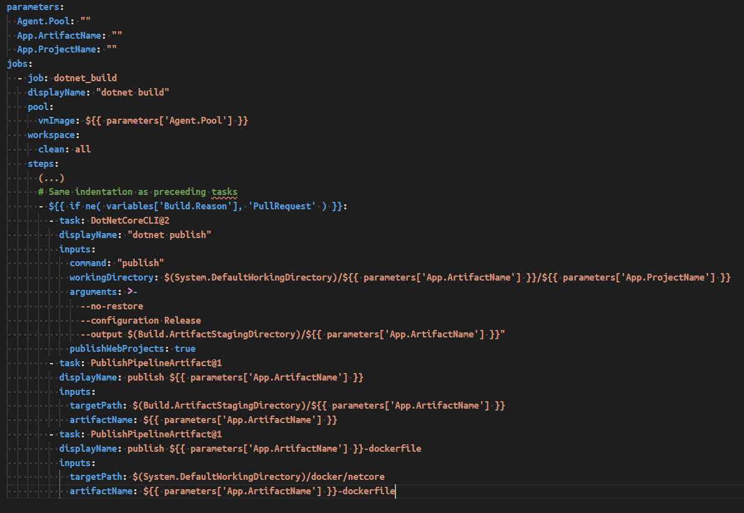
Templates!

Slide 36
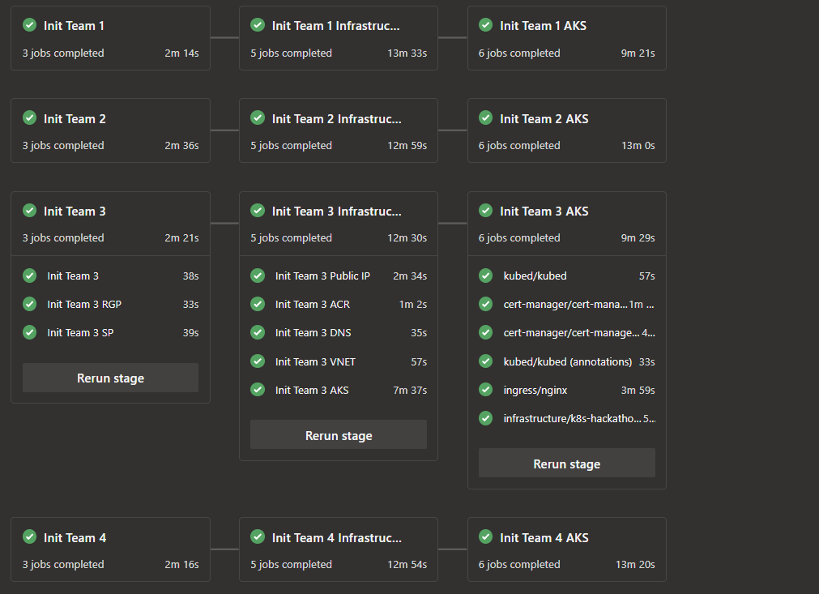

Slide 37
So how do we setup such a pipeline?

Slide 38

DEMO

Slide 39
How to clean up?
kubectl delete namespace {name}
https://success.docker.com/article/kubernetes-namespace-stuck-in-terminating

Slide 40
Let this be an inspiration for what is possible to achieve
I hope it was informative
Don’t be afraid to try it yourself

Slide 41
QUESTIONS ?
Let’s meet in the ATE zone

Slide 42

25.04 @Warsaw #SaveTheDate

Slide 43

Don't forget to rate my session in Mobile App!

Slide 44














